Slide 1
OBSCURE SORROWS Group 18
Daniel Jamieson, Zachari Cooper, Amy Potter, Thomas Turner

Slide 2
The Brief
Emotively engage with the player
Obscure Sorrows

Slide 3
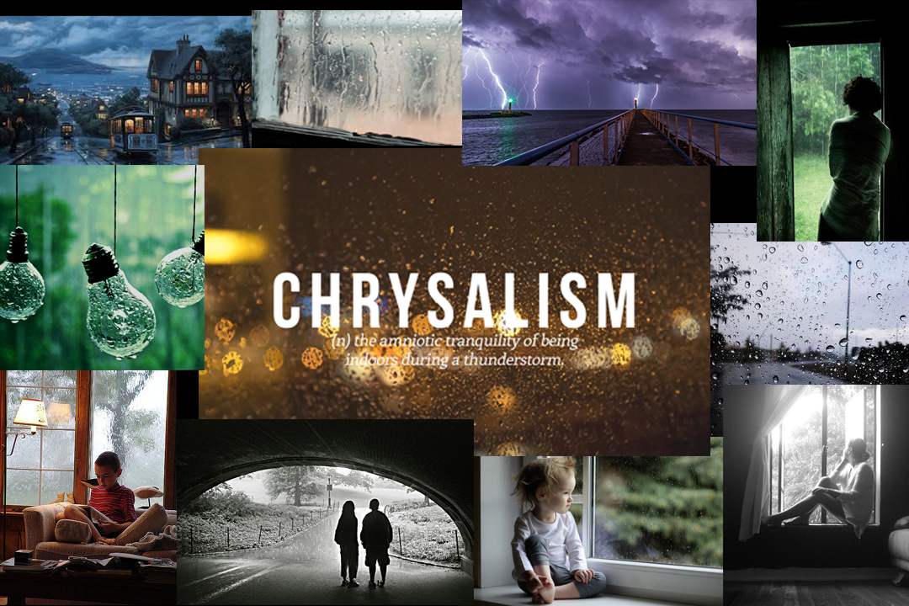
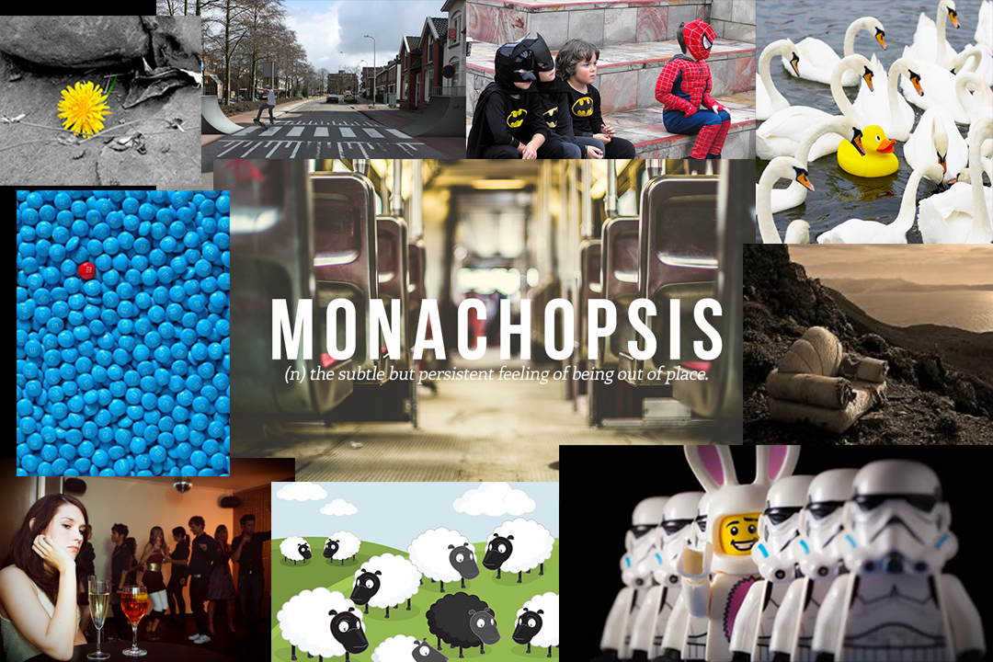
Emotions
Chrysalism: The amniotic tranquillity of being indoors during a thunderstorm.
Monachopsis: The constant but subtle feeling of being out of place.

Slide 4
Developed Idea
Seahorse
Disaster
Reconnect

Slide 5
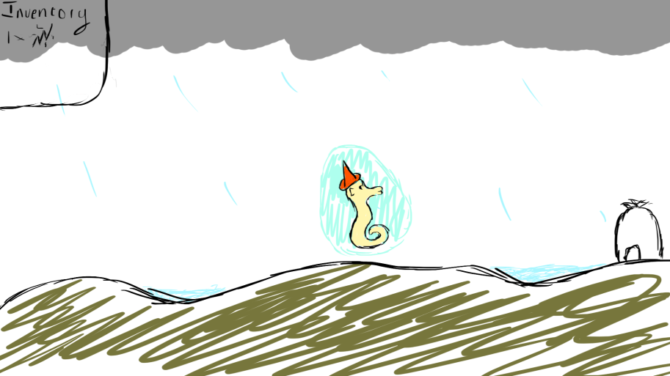
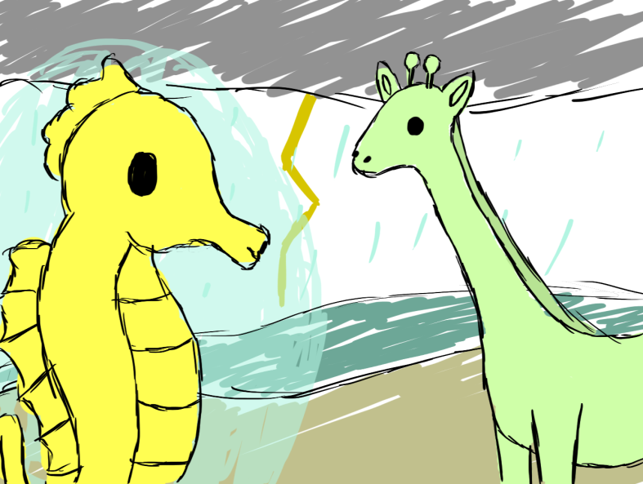
Concept Art

Slide 6
What Will the Player Do?
Guide the Seahorse as the player
Speak and help the inhabitants
Complete tasks and find your belongings and family

Slide 7
What Makes the Game Appealing?
Rhythm
Challenges/puzzles
Rewards/Mementoes

Slide 8
Target Audience
Women
Aged 12 - 16
Genre, Art Style, Game Meaning

Slide 9
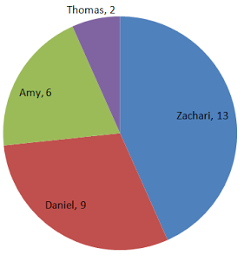
Timescale
10 weeks
Emailing

Slide 10
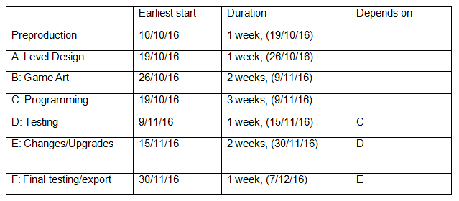

Slide 11
Questions?

